Slide 1
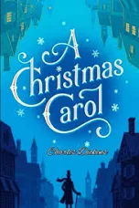



Revision Pack: Literature Paper one

Slide 2
‘Romeo and Juliet’ Contents page
I have 5 minutes:
Around the clock revision.
Revise one of your quote by rotes – ensure you know 2 methods you could use!
Literary Terms.
I have 15 minutes:
Drawing connections between the characters – Task 1.
Conventions of a Shakespearean Tragedy – create flash cards.
Plan for the essay questions in detail.
I have 20 minutes:
Structure worksheet.
Drawing connections between the characters – Task 2.
Order of events.
Juliet – Complete table.
Romeo – Complete table.
Mercutio – Complete table.
Nurse – Complete table.
I have 30 minutes:
‘Fast speeds’ Dramatic Techniques.
Using the Revision Guide you have been given, create flash cards for both the themes and context in ‘Romeo and Juliet’.
Romeo – think deeper – love.
Think Deeper – Youth.
Act 3, Scene 2 – Oxymorons.
Oppositions in ‘Romeo and Juliet’.
Character profiles x8.
Is Romeo a Tragic Hero?
I have 50 minutes:
Exam Practice – Death.
Exam Practice – Friar Lawrence.
Exam Practice – Relationships.

Slide 3
Around the Clock Revision
A way of revising which can break a topic down into 12 sub-categories, where you spend 5 minutes on each category.
How to complete it?
Section 1: Note the main events in the key scenes. Consider the structural elements, for example: Shakespearean Tragedy.
Section 2: List the key contextual elements you could use in your exam.
Section 3: Note down any key terminology you are likely to use when exploring ‘Romeo and Juliet’.
Section 4: List key quotations for Romeo.
Section 5: List key quotations for Juliet.
Section 6: List key quotations for Lord Capulet.
Section 7: List key quotations for Friar Lawrence.
Section 8: Evaluation – list all the reasons Shakespeare might have for presenting the play in the way he does.
Section 9 and 10: List key themes that could come up in your exam – try and attach examples from the play.
Section 11: Analyse 3 quotations (with all elements of analysis, context and evaluation) from your quote by rotes/ones already listed above.
Section 12: Create an essay plan for an example paper in the resource section of this pack.

Slide 4
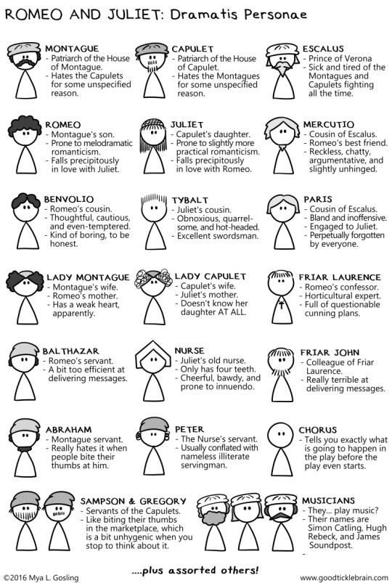
Characters and themes

Slide 5
Dictionary Task/Ambitious Vocabulary use.
In 5 minutes - Look up the definition of a word below, create a flash card with an example from ‘Romeo and Juliet’:
Romeo is:
Infatuation
Desperate
Depressed
Love sick
Rash
Loyal
Loving
Devoted
Brooding
Reckless
Immature
Selfish
Revengeful
Fickle
Idealist
Affectionate
Isolated
Irrational
Emotional
Young
Foolish
Passionate
Superficial
Poetic
Impulsive
Juliet is:
Young
Sensitive
Resourceful
Challenging
Demure
Innocent
Independent
Loyal
Courage
Fortitude
Clever
Innocent
Confident
Naïve
Rebellious
Idealist
Sheltered
Loving
Capable
Rational
Rash
Resolved
Childish
Impatient
Impetuous
Frivolous
coddled

Slide 6
Dictionary Task/Ambitious Vocabulary use.
In 5 minutes - Look up the definition of a word below, create a flash card with an example from ‘Romeo and Juliet’:
Tybalt is:
Fiery
Challenge
Violent
Unpredictable
Aggressive
Swordsman
Angry
Resentful
Stubborn
Protective
Vengeful
Active
Malevolent
Hot-headed
Manipulative
Antagonist
Masculine
Mercutio is:
Light-hearted
Rage
Violent
Provoking
Courage
Aggressive
Loyal
Devoted
Bawdy
Entertaining
Funny
Mocking
Cynical
Hostile
Vulgar
Antagonistic
Courage
Complete word lists for the other characters in ‘Romeo and Juliet’

Slide 7
Drawing connections between the characters (task explanation on the next page):
Capulet
Tybalt
Romeo
Juliet
Montague
Benvolio
Rosaline
Mercutio
Nurse
Friar Lawrence

Slide 8
Drawing connections between the characters – Tasks:
Draw connections between as many of the bubbles. Using a line, you should connect the characters and write an explanation of how they are linked. For example: you might join Romeo and Tybalt and write ‘Romeo kills Tybalt’.
Task 2: Take the above connections and create a concept map onto a piece of A3. Consider the main ideas/themes/messages being communicated by Shakespeare.

Slide 9
Add notes and quotes to these pages to illustrate the character
How JULIET changes throughout the play
Act 1
Act 2
Act 3
Act 4
Act 5
Juliet’s views on love
Juliet’s views on HONOUR
Juliet’s views on her family

Slide 10
Juliet – Complete table
Quotation | Literal Meaning/Analysis
‘…she doth teach the torches to burn bright […] So shows a snowy dove trooping with crows, As yonder lady o’er her fellows shows.’ Romeo
‘Thou knowest the mask of night is on my face, Else would a maiden blush bepaint my cheek For that which thou hast heard me speak tonight.’ Juliet
‘Death lies on her like an untimely frost Upon the sweetest flower of all of the field.’ Capulet
‘Is crimson in thy lips and in thy cheeks, And death’s pale flag is not advanced there.’ Romeo
What is the purpose of Juliet’s character in the play? How does she move the plot forward?

Slide 11
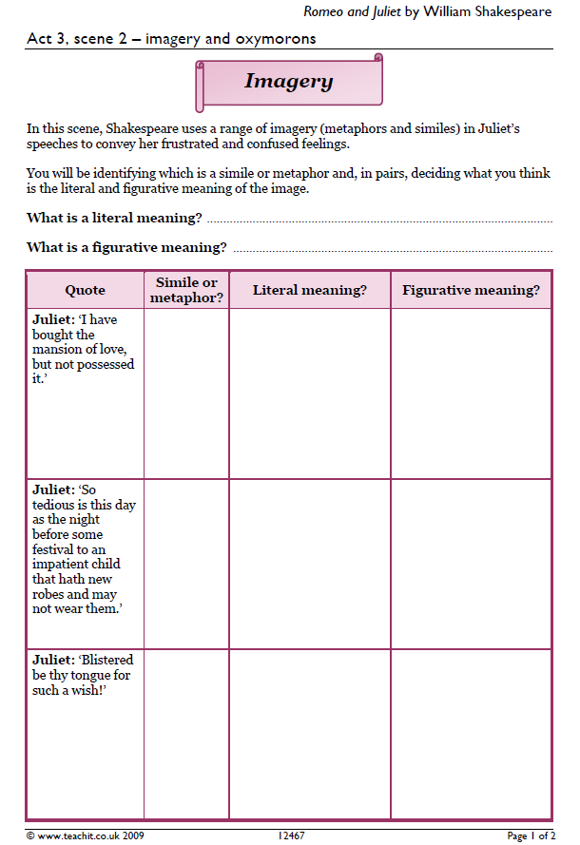

Slide 12
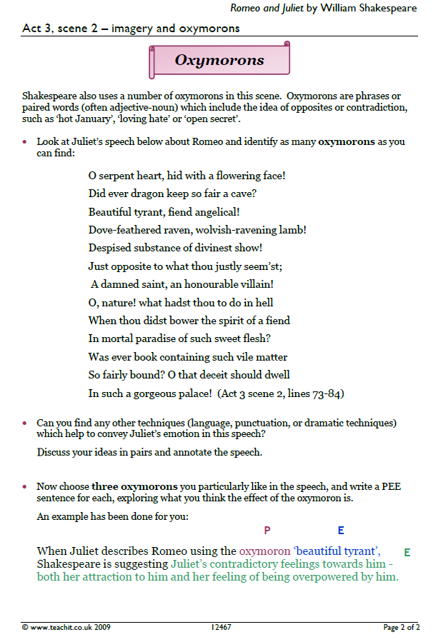

Slide 13
Add notes and quotes to these pages to illustrate the character
How ROMEO changes throughout the play
Act 1
Act 2
Act 3
Act 4
Act 5
Romeo’s view on love
Romeo’s views on FATE (the idea that your life is decided for you)
Romeo’s views on his family

Slide 14
Romeo – complete the table
Quotation | Literal Meaning/Analysis
‘Verona brags of him To be a virtuous and well-governed youth.’ Capulet
‘Why, is not this better now than groaning for love? Now art thou sociable; now art thou Romeo!’ Mercutio
‘O, I am fortune’s fool!’ Romeo
‘…I will stay with thee, And never from this palace of dim night depart again.’ Romeo
What is the purpose of Romeo’s character in the play? How does he move the plot forward?

Slide 15
Romeo – Think Deeper – Love!
Why does Romeo fall in love with Juliet?
Think about:
Romeo’s attitude to love and his disappointment over Rosaline.
Juliet’s beauty and her readiness to commit herself whole-heartedly.
For a high-marked response make sure you comment on the various ways Juliet is attractive to Romeo and if possible come up with your own original ideas. You could explore Romeo’s general behaviour and actions too, and include an interpretation of what they tell us about him (and Juliet).

Slide 16
Mercutio – Complete the table
Quotation | Literal Meaning/Analysis
‘…You have dancing shoes With nimble soles…’ Romeo
‘Peace, peace, Mercutio, peace! Thou talk’st of nothing.’ Romeo
‘O, calm, dishonourable, vile submission! […] Tybalt, you rat-catcher, will you walk?’ Mercutio
‘…brave Mercutio is dead! That gallant spirt hath aspired the clouds, Which too untimely here did scorn the earth.’ Benvolio
What is the purpose of Mercutio’s character in the play? How does he move the plot forward?

Slide 17
Nurse – Complete the table
Quotation | Literal Meaning/Analysis
‘Go Girl. Seek happy nights to happy days.’ Nurse
To Romeo she is a ‘good Nurse’ and ‘my dear Nurse’. Romeo
‘ancient damnation! O most wicked fiend’. Juliet
‘Thou and my bosom hence forth shall be twain.’ Juliet
What is the purpose of Nurse’s character in the play? How does she move the plot forward?

Slide 18
Does PARIS really love Juliet?
Is PARIS honourable?
A modern audience would think…
Paris as a contrast to Romeo
A Shakespearian audience would think…

Slide 19
How does Capulet talk about Juliet in:
Act 1 Scene 2 – to Paris
Act 3 Scene 5 – to Juliet and Lady Capulet
How does this make us feel about a) Capulet and b) Juliet?
Capulet’s views on honour
(especially the feud)
Capulet’s attitude towards family…
Capulet as a contrast to Tybalt…
.

Slide 20
TYBALT’S views on HONOUR
Tybalt’s views on FAMILY
A modern audience would think…
Tybalt on HATE
A Shakespearian audience would think…

Slide 21
Add notes and quotes to these pages to illustrate the character
Mercutio as a contrast to
What Mercutio causes to happen.
Act 1
Act 2
Act 3
Tybalt
Romeo
Mercutio as a source of HUMOUR
Mercutio’s attitude towards honour.

Slide 22
Add notes and quotes to these pages to illustrate the character
How does The Nurse deceive people?
What The NURSE helps happen.
Act 1
Act 2
Act 3
Act 4
The Nurse’s views on LOVE
The Nurse as a source of HUMOUR/COMIC RELIEF

Slide 23
Add notes and quotes to these pages to illustrate the character
What FRIAR Laurence helps happen.
Act 2
Act 3
Act 4
Act 5
How does Friar Laurence deceive people?
Friar Laurence’s views on LOVE
Friar Laurence’s views on FATE
Friar Laurence’s views on VIOLENCE (including self-harm)

Slide 24
Think Deeper - Youth
How do the ages of Romeo and Juliet affect the audience’s understanding of their love affair?
Think about:
Romeo’s impetuousness and desire for action
Juliet’s inability to control her feelings and the openness of her nature
For a high-marked response you need to make sure you comment on the varied ways their youthfulness comes across in the narrative, and if possible come up with your own original ideas for example: do they take more risks because they are younger, or does their innocence make their love purer and stronger as a result?

Slide 25
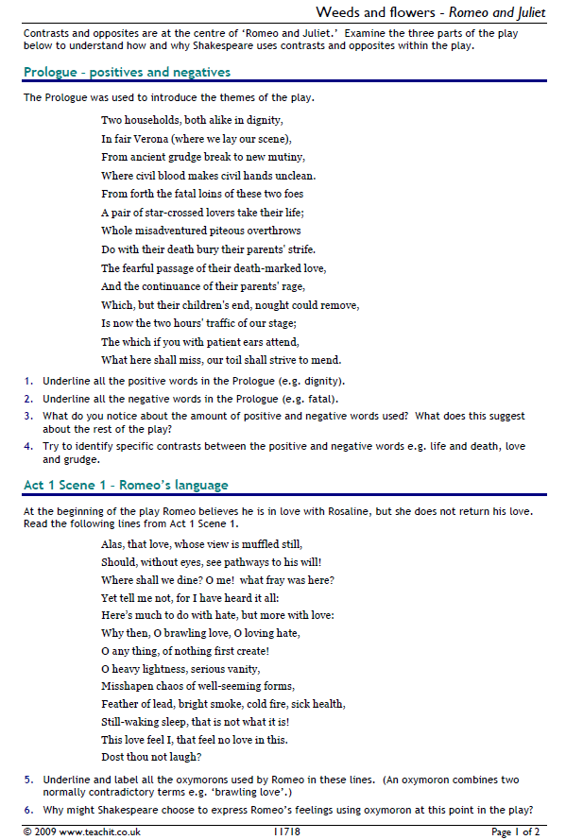

Slide 26
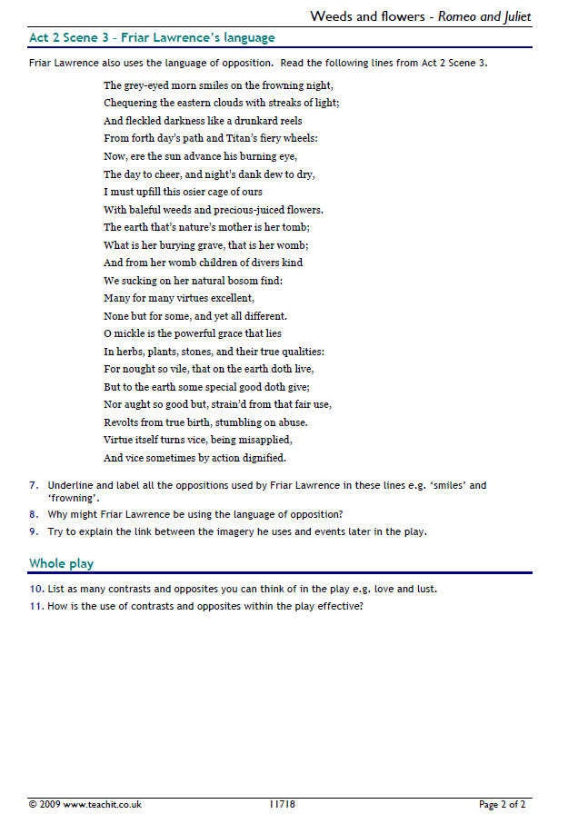

Slide 27
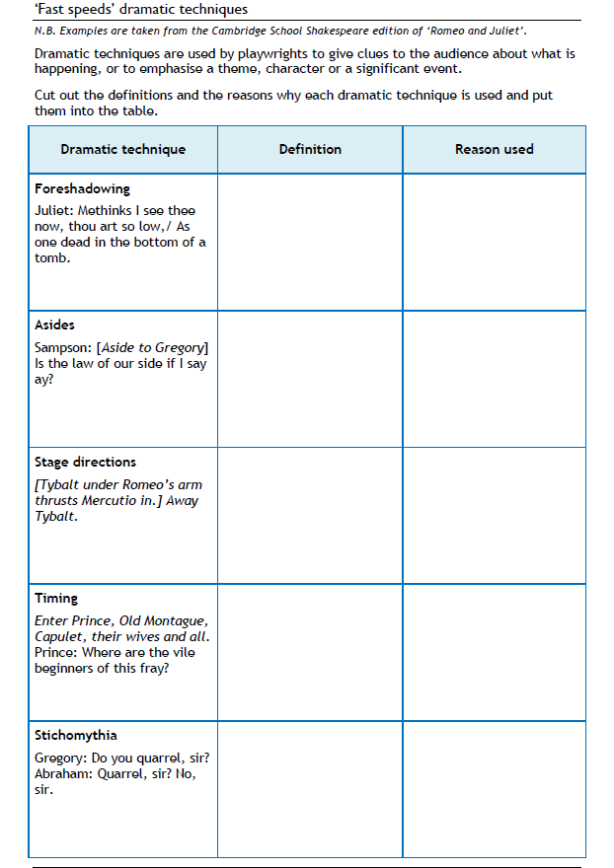

Slide 28
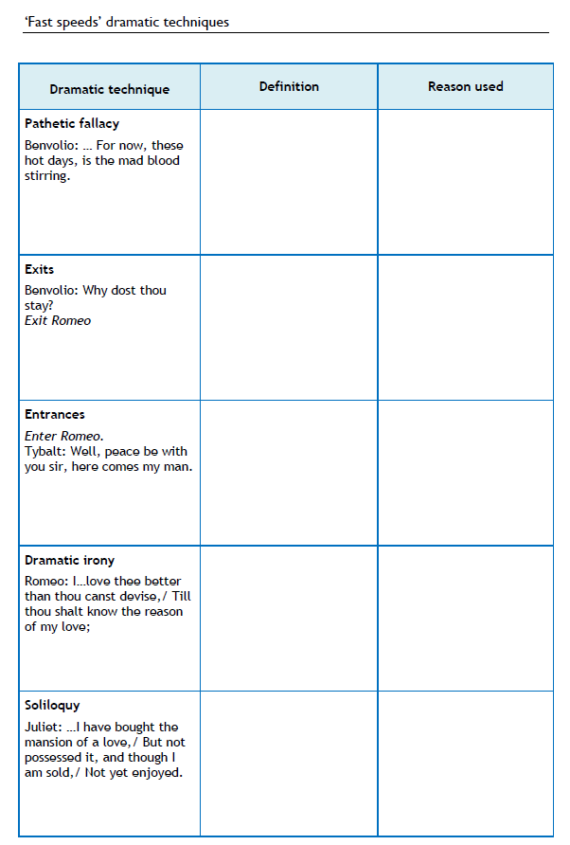

Slide 29
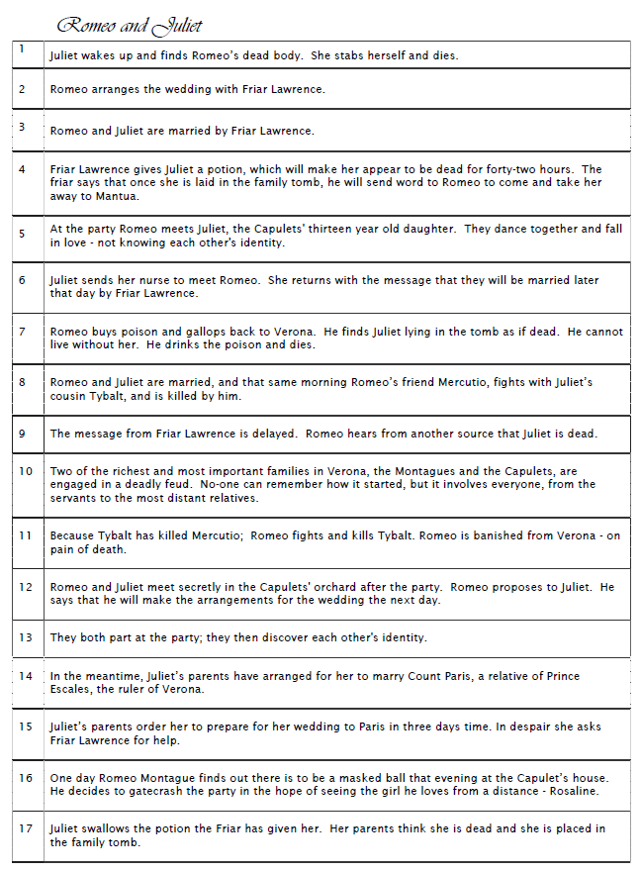

Slide 30

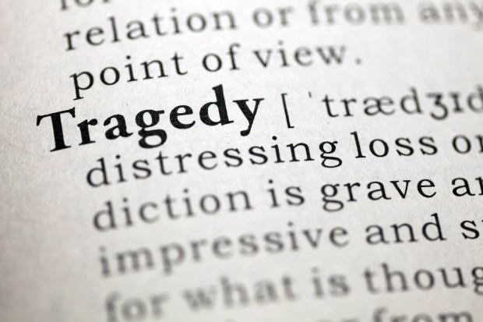
Structure
Or

Slide 31
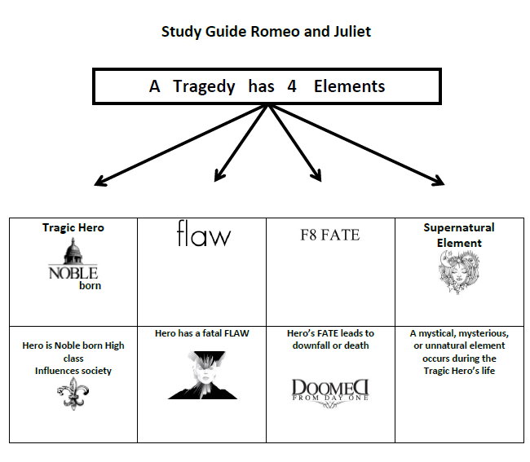

Slide 32
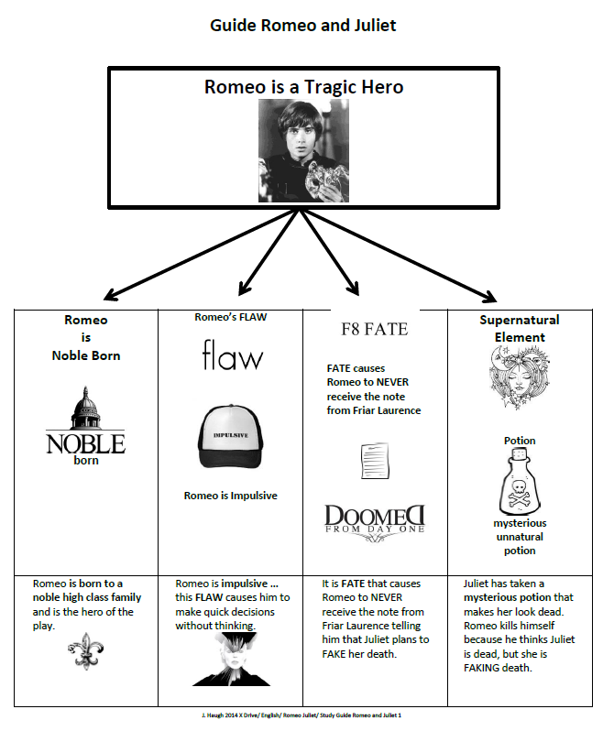

Slide 33
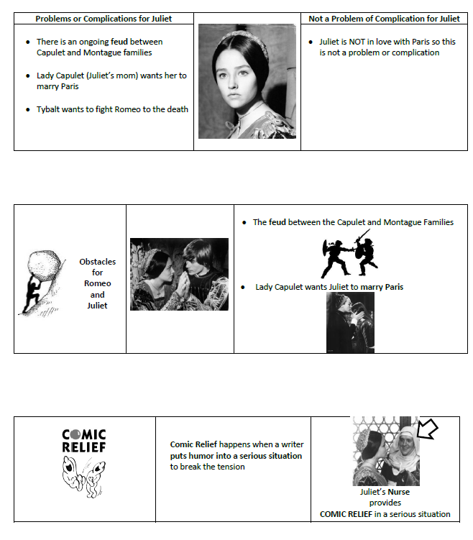

Slide 34
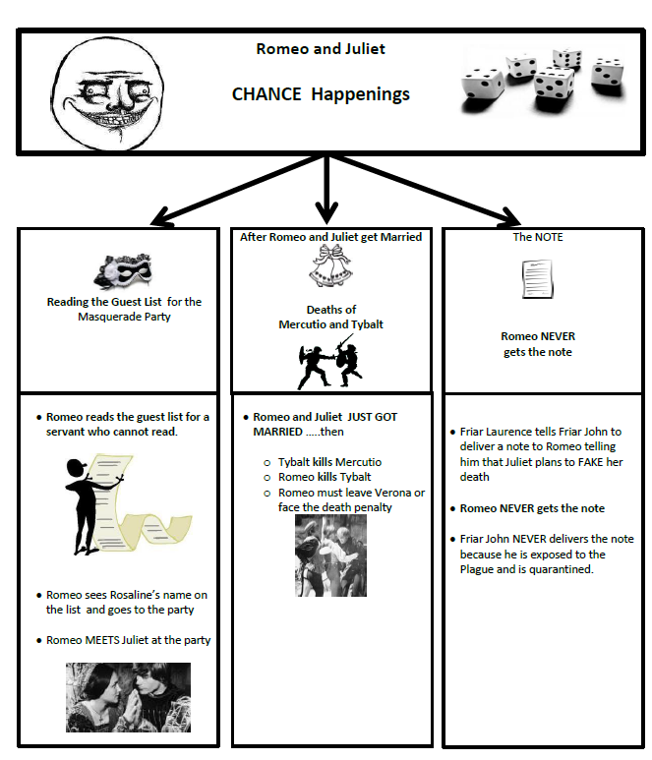

Slide 35
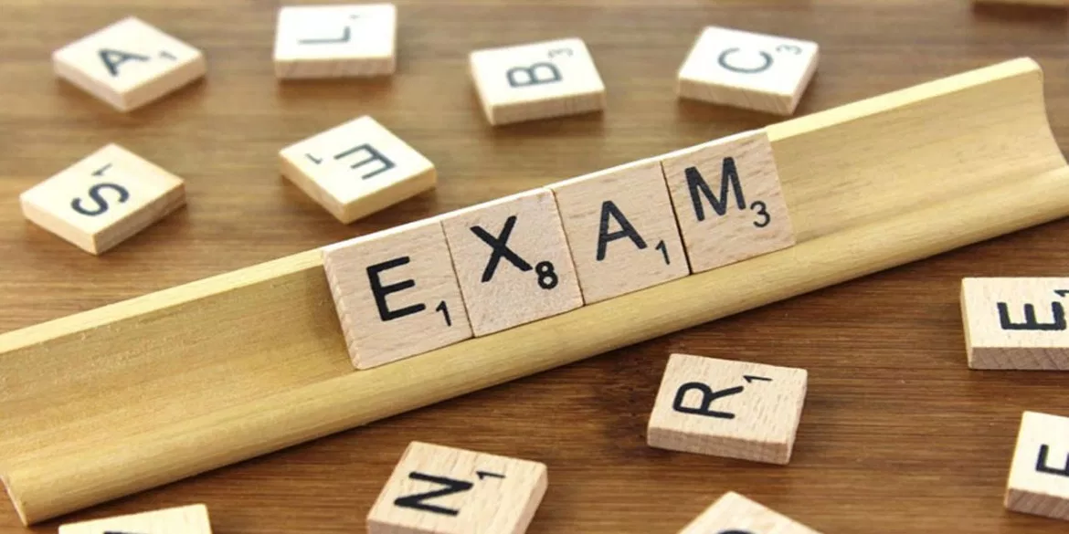
Exam Preparation

Slide 36
Exam Practice - Death
Read the following extract from Act 4 Scene 1 of Romeo and Juliet and then answer the question that follows.
At this point in the play Juliet is due to marry Paris and Romeo has been banished.
FRIAR LAWRENCE
Hold, daughter: I do spy a kind of hope,
Which craves as desperate an execution.
As that is desperate which we would prevent.
If, rather than to marry County Paris,
Thou hast the strength of will to slay thyself,
Then is it likely thou wilt undertake
A thing like death to chide away this shame,
That copest with death himself to scape from it:
And, if thou darest, I'll give thee remedy.
JULIET
O, bid me leap, rather than marry Paris,
From off the battlements of yonder tower;
Or walk in thievish ways; or bid me lurk
Where serpents are; chain me with roaring bears;
Or shut me nightly in a charnel-house,
O'er-cover'd quite with dead men's rattling bones,
With reeky shanks and yellow chapless skulls;
Or bid me go into a new-made grave
And hide me with a dead man in his shroud;
Things that, to hear them told, have made me tremble;
And I will do it without fear or doubt,
To live an unstain'd wife to my sweet love.
Starting with this speech, explore how Shakespeare presents attitudes to death in Romeo and Juliet.
Write about:
how Shakespeare presents attitudes towards death in this extract
how Shakespeare presents attitudes towards death in the play as a whole

Slide 37
Exam Practice – Friar Lawrence
Read the following extract from Act Scene 3 of Romeo and Juliet and then answer the question that follows.
At this point in the play Romeo has gone to tell Friar Lawrence about meeting Juliet.
ROMEO
Thou chid'st me oft for loving Rosaline.
FRIAR LAWRENCE
For doting, not for loving, pupil mine.
ROMEO
And bad'st me bury love.
FRIAR LAWRENCE
Not in a grave,
To lay one in, another out to have.
ROMEO
I pray thee, chide not; she whom I love now
Doth grace for grace and love for love allow;
The other did not so.
FRIAR LAWRENCE
O, she knew well
Thy love did read by rote and could not spell.
But come, young waverer, come, go with me,
In one respect I'll thy assistant be;
For this alliance may so happy prove,
To turn your households' rancour to pure love.
ROMEO
O, let us hence; I stand on sudden haste.
FRIAR LAWRENCE
Wisely and slow; they stumble that run fast.
10
Starting with this extract, explore how Shakespeare presents Friar Lawrence in Romeo and Juliet.
Write about:
how Shakespeare presents Friar Lawrence in this extract
how Shakespeare presents Friar Lawrence in the play as a whole

Slide 38
Exam Practice - Relationship
Read the following extract from Act 3 Scene 5 of Romeo and Juliet and then answer the question that follows.
At this point in the play Romeo is about to leave for Mantua, where he has been banished for killing Tybalt.
JULIET
Wilt thou be gone? it is not yet near day:
It was the nightingale, and not the lark,
That pierced the fearful hollow of thine ear;
Nightly she sings on yon pomegranate-tree:
Believe me, love, it was the nightingale.
ROMEO
It was the lark, the herald of the morn,
No nightingale: look, love, what envious streaks
Do lace the severing clouds in yonder east:
Night's candles are burnt out, and jocund day
Stands tiptoe on the misty mountain tops.
I must be gone and live, or stay and die.
JULIET
Yon light is not day-light, I know it, I:
It is some meteor that the sun exhales,
To be to thee this night a torch-bearer,
And light thee on thy way to Mantua:
Therefore stay yet; thou need'st not to be gone.
ROMEO
Let me be ta'en, let me be put to death;
I am content, so thou wilt have it so.
I'll say yon grey is not the morning's eye,
'Tis but the pale reflex of Cynthia's brow;
Nor that is not the lark, whose notes do beat
The vaulty heaven so high above our heads:
I have more care to stay than will to go:
Come, death, and welcome! Juliet wills it so.
How is't, my soul? let's talk; it is not day.
Starting with this extract, explore how Shakespeare presents Romeo and Juliet’s relationship.
Write about:
how Shakespeare presents Romeo and Juliet’s relationship in this extract
how Shakespeare presents Romeo and Juliet’s relationship in the play as a whole

Slide 39
‘A Christmas Carol’ Contents Page
I have 5 minutes:
Around the clock revision
Quote by rote
Literary Terms – pick three literary techniques (e.g., symbolism, pathetic fallacy, personification) and write a short definition with an example from the novella.
I have 15 minutes:
Drawing connections between the characters - Task 1
Conventions of a Victorian novella
Plan for the essay questions in detail
I have 20 minutes:
Structure worksheet
Drawing connections between the characters – Task 2
Order of events
Scrooge – Complete table
Tiny Tim – Complete table
Bob Cratchit – Complete table
Marley – Complete table
I have 30 minutes:
‘Fast speeds’ Dramatic Techniques
Themes and context flashcards
Scrooge – think deeper: greed and redemption
Think deeper – social inequality
Stave 2 – Scrooge’s childhood
Oppositions in A Christmas Carol
Character profiles x8
Is Scrooge a moral hero?
I have 50 minutes:
Exam Practice

Slide 40
Around the Clock Revision
A way of revising which can break the novella down into 12 sub-categories, where you spend 5 minutes on each category.
How to complete it:
Section 1: Note the main events in each Stave. Consider the structural elements, for example: the novella as a morality tale, use of supernatural, and the narrative arc of Scrooge’s transformation.
Section 2: List the key contextual elements you could use in your exam – for example: Victorian society, industrialisation, class division, attitudes to poverty, and Dickens’ purpose as a social reformer.
Section 3: Note down any key terminology you are likely to use when exploring A Christmas Carol, e.g., symbolism, pathetic fallacy, personification, allegory, morality tale.
Section 4: List key quotations for Scrooge.
Section 5: List key quotations for Tiny Tim.
Section 6: List key quotations for Bob Cratchit.
Section 7: List key quotations for Marley.
Section 8: Evaluation, list all the reasons Dickens might have for presenting the novella in the way he does (e.g., moral lesson, critique of society, emotional engagement of reader).
Section 9 and 10: List key themes that could come up in your exam, try to attach examples from the text. Examples: redemption, greed, social responsibility, family, consequences of selfishness.
Section 11: Analyse 3 quotations (with all elements of analysis, context, and evaluation) from your quote by rotes/ones already listed above.
Section 12: Create an essay plan for an example exam question in the resource section of this pack, e.g., How does Dickens present Scrooge’s transformation in A Christmas Carol?

Slide 41
Quote by Rote
Step 1: Write down your chosen quotation.
Step 2: Mind Map/Analysis Prompts
Prompt | Your Notes
Who says it? | Who is the speaker and what do we learn about them from this quote?
When/Where in the novella? | Which Stave does it appear in? What is happening in the plot?
Key Words/Phrases | Highlight powerful words or phrases and consider why Dickens chose them.
Literary/Language Techniques | E.g., imagery, symbolism, alliteration, personification – how do they affect the reader?
Effect on the Reader | How might Dickens want the reader to feel or think here?
Links to Themes | Which theme(s) does this quote connect to? (e.g., redemption, social inequality, family, morality)
Context | How does this quote reflect Victorian society or Dickens’ purpose?
Evaluation | Why is this quote important for understanding Scrooge/other characters or the novella as a whole?
Methods | Pick 2 methods you could discuss in an exam paragraph (e.g., symbolism, pathetic fallacy).
Step 3: Quick Exam Tip
Try to memorise the quote word for word. When revising, cover your notes and test yourself: can you recall the quote, its context, and how to analyse it?

Slide 42
Mapping Relationships
Instructions:
Draw a central circle for Scrooge – he is the main character.
Around Scrooge, draw circles for: Tiny Tim, Bob Cratchit, Ghost of Christmas Past, Ghost of Christmas Present, Ghost of Christmas Yet to Come, and Marley.
Use arrows or lines to show relationships. Label each line with:
  How they feel about each other
  How they influence or change each other
  Key quotes or actions that demonstrate their relationship
Add notes on themes that each relationship highlights (e.g., redemption, social responsibility, family, consequences of selfishness).
Include any conflicts or contrasts – e.g., Scrooge’s coldness vs. the Cratchits’ warmth.
Relationship | Questions to Consider | Example Notes
Scrooge - Tiny Tim | How does Scrooge react to Tim? How does Tim influence Scrooge’s change? | Tim’s illness highlights Scrooge’s past selfishness and inspires his redemption.
Scrooge - Bob Cratchit | How does Scrooge treat Bob at the start vs. end? What does this show about his character? | Scrooge’s initial cruelty vs. generosity at the end.
Scrooge - Spirits | What does each Spirit teach him? How do they change his perspective? | Past shows mistakes, Present shows consequences, Yet to Come shows mortality/fear.
Tiny Tim - Bob Cratchit | How does their relationship highlight family and social issues? | Love, care, and hardship; illustrates Dickens’ social critique.

Slide 43
Conventions of a Victorian Novella
Instructions:
List the main conventions of a Victorian novella. Examples include:
  Morality tale
  Redemption
  Supernatural
  Social critique
  Family values
  Emotional appeal / sentimentality
  Didactic purpose (teaching a lesson)
  Clear moral contrast (good vs. evil)
Create flash cards for each convention:
  Front of the card: Name of the convention (e.g., Redemption)
  Back of the card:
    Definition / explanation of the convention
    Example from A Christmas Carol (quote or event)
    How Dickens uses this convention to influence the reader
Optional tip: Use colours or symbols to help remember conventions. For example:
  Green for positive themes (e.g., redemption, family)
  Red for warnings or consequences (e.g., greed, neglect)
Example Flash Card:
Front: Redemption
Back:
Definition: A character changes for the better, learning from mistakes.
Example: Scrooge transforms from a miser to a generous, caring man.
Effect: Shows readers that change is possible and reinforces Dickens’ moral message.

Slide 44
Essay Planning with What, How, Why
Instructions:
Choose an essay question from your resource pack or use an example:
  “How does Dickens present Scrooge’s transformation in A Christmas Carol?”
Plan your paragraphs using the following structure:
Paragraph | What | How | Why
1 | What happens in the story or what point you want to make | How Dickens presents this (techniques, language, structure, context) | Why this is important – effect on reader, theme, or message
2
3
4
Tips for completing the table:
What: Identify the key event, character action, or idea.
How: Focus on literary techniques (e.g., imagery, symbolism, dialogue, narrative structure).
Why: Explain the purpose or effect – why Dickens chose this approach and how it links to themes or context.
Add supporting quotes in the “How” column to strengthen your points.
Optional extension: Think of alternative interpretations or counterpoints to include in your essay for extra depth.

Slide 45
Structure Worksheet: Breaking Down A Christmas Carol
Instructions:
Divide your worksheet by Stave (1–5).
For each Stave:
  List the key events in chronological order.
  Note how Scrooge changes or what is revealed about his character.
  Highlight turning points that show his progression toward redemption.
Use quotes where relevant to support your points.
Stave | Key Events | Scrooge’s Character / Turning Points | Quotes
1 – Marley’s Ghost
2 – The First of the Three Spirits
3 – The Second of the Three Spirits
4 – The Last of the Spirits
5 – The End of It
Prompts for Each Column:
Key Events:
  What happens in the Stave? (Plot points, major incidents)
  Who is involved?
  Any important settings or context?
Scrooge’s Character / Turning Points:
  How does Scrooge react to events?
  Does he show emotion, fear, or reflection?
  Identify moments where his attitude shifts toward generosity or empathy.
Quotes:
  Include at least one key quotation per Stave that illustrates Scrooge’s behaviour or the message Dickens conveys.

Slide 46
Comparing Scrooge’s Relationships: Marley vs. the Spirits
Instructions:
Use the table below to organise your ideas.
For each relationship, consider:
  How the other character influences Scrooge
  How Scrooge reacts
  Key quotes and events
  Thematic significance (e.g., redemption, consequences, morality)
Identify similarities and differences between Marley and the Spirits.
Relationship | How the character influences Scrooge | Scrooge’s reaction / feelings | Key quotes / events | Themes highlighted
Marley | Warns Scrooge of the consequences of his selfish life; foreshadows his fate | Fear, shock, unease; first step toward reflection | “I wear the chain I forged in life.” | Consequences, morality, supernatural
The Spirits | Teach Scrooge lessons about past, present, and future; guide him to change | Initially resistant/fearful, then reflective; begins to feel regret, empathy, generosity | Ghost of Christmas Past: “A solitary child, neglected by his friends…” Ghost of Christmas Present: “There is nothing in the world so irresistibly contagious as laughter and good humor.” Ghost of Christmas Yet to Come: silent, terrifying presence | Redemption, empathy, social responsibility, transformation
Prompts to Consider:
Purpose: Why does Dickens introduce Marley first, then the Spirits?
Contrast: Marley warns without guidance; Spirits actively teach and guide.
Effect on reader: How do these relationships make us reflect on morality, time, and consequences?
Connection to themes: How does each relationship emphasise Dickens’ key messages?

Slide 47
Order of Events: Scrooge’s Transformation
Instructions:
Below is a list of major events from the novella (some are mixed up). Arrange them in the order they happen in the story.
For each event, write how it affects Scrooge – what does he learn, feel, or change?
Add quotes or key phrases if possible.
Extension / Reflection:
Identify the top three events that were key turning points in Scrooge’s transformation.
Explain why Dickens arranged the events in this order – how does the structure build suspense, emotion, and moral lessons?
Event | Order (1–10) | Impact on Scrooge / Notes | Quotes
Scrooge refuses to give to charity |  | Shows his greed and selfishness | “Are there no prisons? Are there no workhouses?”
Marley’s ghost visits |  | Warns him about the consequences of his life; first moment of fear | “I wear the chain I forged in life.”
Scrooge sees his childhood |  | Reflects on lost opportunities; feels regret | “A solitary child, neglected by his friends…”
Scrooge observes the Cratchits |  | Realises the suffering of the poor; begins to feel empathy | “God bless us, every one!”
Ghost of Christmas Present shows the joy of generosity |  | Begins to understand the importance of kindness | “There is nothing in the world so irresistibly contagious as laughter and good humor.”
Scrooge sees his own death / future |  | Experiences fear and dread; realises he must change | Silent, ominous imagery of the Ghost of Christmas Yet to Come
Scrooge wakes on Christmas morning |  | Decides to change his life; demonstrates generosity | “I will honour Christmas in my heart, and try to keep it all the year.”
Scrooge donates to charity and helps the Cratchits |  | Shows full transformation; now caring and generous | “He became as good a friend, as good a master…”
Scrooge celebrates with Fred |  | Reconnects with family and joy | “He was better than his word.”
Tiny Tim survives and thrives |  | Outcome of Scrooge’s change; hope and happiness | “God bless us, every one!”

Slide 48
Scrooge: Character Table
Instructions:
Fill in the table below, focusing on Scrooge’s traits at the start, middle, and end of the story.
Include key quotes to support your points.
Consider how Dickens presents him through language, actions, and interactions with others.
Stage of the Novella | Scrooge’s Traits / Personality | Key Events / Actions | Key Quotes
Start
Middle
End
Prompts to Guide You:
Start:
  How does Scrooge behave toward money, family, and society?
  Is he selfish, miserly, cold, or unfeeling?
  Example quote: “Bah! Humbug!”
Middle:
  How do the visits of Marley and the Spirits affect him?
  Is he reflective, fearful, regretful?
  Example: Seeing his past and the Cratchits.
End:
  How has he changed?
  Is he generous, kind, and socially responsible?
  Example: Giving to charity, celebrating Christmas with Fred and the Cratchits.

Slide 49
Tiny Tim: Character Table
Instructions:
Fill in the table below with Tiny Tim’s key traits, important quotes, and significance.
Think about how Dickens uses Tiny Tim to influence the reader and support the novella’s themes.
Aspect | Notes / Examples
Key Traits | Kind, innocent, optimistic, courageous, moral, vulnerable due to illness
Key Quotes | Example: “God bless us, every one!” Example: “Tiny Tim hoped the people saw him in the church, because he was a cripple, and it might be pleasant to them to remember upon Christmas Day…”
Significance / Role in Novella | Highlights social injustice and the struggles of the poor - Inspires compassion in Scrooge - Symbolises hope, innocence, and the potential for change - Reinforces Dickens’ message about family, charity, and moral responsibility
Prompts for You:
How does Tiny Tim contrast with Scrooge at the start of the novella?
How do other characters react to him, and what does this reveal about them?
Why might Dickens have chosen to make Tim a child and physically vulnerable?
How does Tim’s health and optimism highlight themes of redemption, generosity, and social responsibility?

Slide 50
Bob Cratchit: Character Table
Instructions:
Fill in the table below with Cratchit’s traits, key aspects of his family life, and significance.
Include quotes where relevant.
Consider how Dickens uses Cratchit to contrast with Scrooge and to explore social issues.
Aspect | Notes / Examples
Personality / Traits | Hardworking, kind, patient, humble, loyal, optimistic despite hardship
Family Life | - Devoted father and husband - Cares deeply for Tiny Tim and the family - Celebrates Christmas with love and warmth despite poverty
Role in Highlighting Social Themes | - Shows the struggles of the poor and working class - Highlights social inequality - Inspires Scrooge’s transformation - Emphasises Dickens’ messages about generosity, family, and compassion
Key Quotes | Example: “A merry Christmas to us all, my dears. God bless us!” Example: “The clerk’s fire was so very much smaller that it looked like one coal.”
Prompts for You:
How does Cratchit’s humility and kindness contrast with Scrooge’s initial greed?
How does his treatment of his family reflect Victorian ideals of morality and love?
How does Dickens use Cratchit to make the reader sympathise with the poor and question social inequalities?

Slide 51
Marley: Character Table
Instructions:
Fill in the table below with Marley’s role, symbolic meaning, and impact on Scrooge.
Include quotes where relevant.
Consider how Dickens uses Marley to introduce the supernatural and moral lessons.
Aspect | Notes / Examples
Purpose | - Warns Scrooge about the consequences of selfishness - Introduces the supernatural element - Acts as a catalyst for Scrooge’s transformation
Symbolism | - Chains: consequences of greed and sin - Ghost: warning of mortality and moral responsibility - His appearance: fear, regret, and moral lesson
Effect on Scrooge | - Sparks fear and reflection - Forces Scrooge to consider his past, present, and future actions - Motivates him to heed the lessons of the Spirits
Key Quotes | “I wear the chain I forged in life.” “Mankind was my business.”
Prompts for You:
How does Marley’s appearance set the tone for the novella?
How does his warning contrast with the teaching role of the Spirits?
Why might Dickens have chosen a former business partner to deliver this message?
How does Marley’s symbolism connect to the themes of redemption, morality, and consequences?

Slide 52
‘Fast Speeds’ Dramatic Techniques
Instructions:
Read key scenes where the supernatural events occur (e.g., visits from Marley and the three Spirits).
Identify how Dickens manipulates the pace of the narrative to create suspense, urgency, or excitement.
Record techniques, examples, and effects in the table below.
Scene / Event | Technique Used | Effect on Reader / Purpose | Quote / Example
Marley’s ghost appears | Short, abrupt sentences; exclamations; eerie descriptions | Creates fear, shock, and suspense; makes the reader anticipate what will happen next | “It was a dismal, droning sound in the air…”
Ghost of Christmas Past arrives | Sudden transition from present to past; vivid imagery | Heightens curiosity and wonder; makes Scrooge and the reader reflect quickly | “A solitary child, neglected by his friends…”
Ghost of Christmas Present shows Cratchit family | Rapid shifts between locations and characters; lively dialogue | Builds excitement and emotional engagement; contrasts Scrooge’s coldness with warmth | “There is nothing in the world so irresistibly contagious as laughter and good humor.”
Ghost of Christmas Yet to Come | Silence, slow pacing, long descriptive passages | Builds dread and tension; suspense about Scrooge’s fate | “The Phantom slowly, gravely, silently approached.”
Prompts for You:
How does Dickens speed up or slow down the narrative to emphasise key moments?
Which literary techniques create suspense? (e.g., short sentences, exclamation marks, foreshadowing, dramatic irony)
How do these techniques affect the reader’s emotions?
How does pace contribute to Scrooge’s transformation and the moral lesson?

Slide 53
Themes and Context Flashcards
Instructions:
Use your revision guide or notes to identify themes and contextual elements.
For each flashcard:
  Front: Theme or Context Title (e.g., “Redemption” or “Victorian Poverty”)
  Back:
    Definition / Explanation
    Example from the text (quote, event, or character)
    Effect / Significance – why Dickens includes this, or how it impacts the reader
Suggested Themes:
Redemption – Scrooge’s transformation; moral lessons
Poverty – Cratchit family struggles; social critique
Social Responsibility – Encouraging charity and compassion
Family – Importance of family relationships, Cratchits vs. Scrooge
Greed vs. Generosity – Contrasts Scrooge’s wealth hoarding with acts of kindness
Supernatural – Ghosts as agents of moral and emotional change
Suggested Contextual Elements:
Victorian Society – Class structure, wealth inequality, attitudes to the poor
Industrialisation – Urbanisation, working conditions, social problems
Dickens’ Purpose – Social reform, morality, educating the reader
Christmas Traditions – Festive spirit, family gatherings, cultural significance
Example Flashcard:
Front: Redemption
Back:
Definition: A character changes for the better, learning from mistakes
Example: Scrooge transforms from miser to generous man
Significance: Shows readers that change is possible; reinforces moral message
Extension / Tips:
Use different colours for themes vs. context for quick visual memory.
Try to memorise a quote for each theme to strengthen exam answers.
Test yourself by looking at the front of the card and explaining the back without looking.

Slide 54
Scrooge: Think Deeper (Greed and Redemption)
Instructions:
Read key scenes that show Scrooge’s selfishness and his change:
  Early interactions with charity collectors and Bob Cratchit
  Visits from Marley and the Ghosts
  Scrooge’s actions on Christmas morning
Use the table below to structure your thinking. Include quotes, techniques, and impact.
Aspect | Notes / Examples | Quote / Evidence | Effect / Analysis
Greed at the Start | Miserly, values money over people, avoids social interaction | “Bah! Humbug!” | Shows selfishness; sets up contrast for transformation
Catalysts for Change | Fear of Marley, supernatural visits, reflection on past, present, future | “I wear the chain I forged in life.” | Builds suspense; forces moral reflection
Emerging Awareness | Begins to feel regret and empathy; realises consequences of actions | Observing Cratchit family, Tiny Tim’s frailty | Shows compassion developing; Dickens’ moral lesson
Redemption / Transformation | Generous, joyful, socially responsible; values relationships | “I will honour Christmas in my heart, and try to keep it all the year.” | Full character arc; reinforces theme of moral change
Prompts for You:
How does Dickens use language, imagery, and narrative structure to show greed and transformation?
What motivates Scrooge to change? Fear, guilt, compassion?
How does Scrooge’s change reflect Dickens’ message about generosity and social responsibility?
Compare early and later behaviour to emphasise the depth of his transformation.

Slide 55
Think Deeper: Social Inequality
Instructions:
Focus on scenes that highlight social inequality:
  The Cratchit family’s struggles
  Scrooge’s initial attitude toward the poor
  Charity collectors and public reactions
Use the table below to structure your thinking. Include examples, quotes, techniques, and Dickens’ message.
Aspect | Notes / Examples | Quote / Evidence | Effect / Analysis
Depiction of Poverty | Cratchits’ hardships, Tiny Tim’s illness, working-class struggles | “The clerk’s fire was so very much smaller that it looked like one coal.” | Highlights inequality; evokes sympathy and moral concern
Wealth and Indifference | Scrooge’s initial greed and lack of compassion | “Are there no prisons? Are there no workhouses?” | Critiques upper-class indifference; reflects Victorian social issues
Importance of Charity | Acts of giving, generosity, social responsibility | Scrooge donates to charity, helps the Cratchits | Shows moral redemption; reinforces Dickens’ call for social reform
Dickens’ Message | Social responsibility, compassion, moral duty to the poor | Overall tone and narrative arc | Encourages readers to act morally and challenge social injustice
Prompts for You:
How does Dickens use characters, events, and language to highlight social inequality?
How does the contrast between Scrooge and the Cratchits emphasise wealth disparity?
Which literary techniques (imagery, symbolism, exaggeration) reinforce his message?
How is the theme of charity linked to Scrooge’s redemption and the moral of the novella?

Slide 56
Stave 2: Scrooge’s Childhood
Instructions:
Re-read Stave 2, focusing on Scrooge’s childhood memories and early life.
Use the table below to analyse:
  What Dickens shows us about Scrooge’s childhood.
  How memory is presented as a narrative technique.
  How these memories contribute to Scrooge’s emotional and moral development.
Memory Scene | What Dickens Shows | How It Shapes Scrooge | Quotes / Techniques
Scrooge as a lonely child | Isolation, neglect, abandonment | Explains Scrooge’s bitterness and emotional coldness | “A solitary child, neglected by his friends, is left there still.”
Reading imaginary friends in books | Uses imagination as comfort in loneliness | Suggests creativity but also reinforces isolation | “He was conscious of a thousand odours floating in the air…”
Scrooge’s sister Fan | Shows family affection and hope | Reminds him of warmth and love; foreshadows Fred | “Always a delicate creature, whom a breath might have withered.”
Fezziwig’s Christmas party | Joyful, generous employer | Contrast to Scrooge as a harsh master; sparks guilt | “The happiness he gives, is quite as great as if it cost a fortune.”
Break with Belle | Chooses wealth over love | Root of his greed and regret | “Another idol has displaced me… a golden one.”
Prompts for You:
How does Dickens use memory to humanise Scrooge and make the reader empathise with him?
Why does Dickens show both positive and painful memories?
How does Stave 2 act as an early turning point in Scrooge’s redemption?
How do these scenes link to Dickens’ wider themes of family, greed, and redemption?

Slide 57
Oppositions in ‘A Christmas Carol’
Instructions:
On the page you’ll find three large “versus” diagrams (like boxing posters / debate cards).
For each pair of oppositions, fill in:
  Examples from the text (scenes, characters, or descriptions).
  Key quotes that capture the contrast.
  Why Dickens uses this opposition (the effect on readers).
Around each opposition, add doodles / keywords / quick images (e.g., a candle for light, coins for wealth).
1. Light vs. Dark
Light → hopeful, joyful, moral clarity
Dark → ignorance, fear, greed
Add quotes (e.g., “It was a bright clear jet of light.” / “Darkness is cheap, and Scrooge liked it.”)
Explain how light = redemption and knowledge, while dark = greed and ignorance.
2. Past vs. Present
Past → childhood, regret, lost opportunities
Present → joy, family, generosity
Add quotes (e.g., Belle’s breakup vs. the Cratchits’ Christmas).
Think about how Scrooge is shown what he missed compared to what he could still embrace.
3. Rich vs. Poor
Rich → Scrooge’s wealth, indifference
Poor → Cratchits’ warmth, Tiny Tim’s fragility
Add quotes (e.g., “Decrease the surplus population.” / “They were happy, grateful, pleased with one another.”)
Reflect on Dickens’ social message: wealth should be used for good.

Slide 58
Extension Prompt:
At the bottom of the page, answer:
Which opposition is the most important in driving Scrooge’s transformation? Why?

Slide 59
Character Profiles (x8)
Instructions:
For each of the eight characters, complete the profile sheet.
Include:
  Key Traits – their personality/role.
  Key Quotes – evidence you could use in an essay.
  Significance / Purpose – why Dickens included them.
  Symbols / Themes – what they represent.
Aim for at least 3 quotes per character.
Characters to Profile:
Scrooge – transformation, greed → redemption
Marley – warning, chains as consequences of greed
Bob Cratchit – family, working-class struggles, kindness
Tiny Tim – innocence, fragility, moral lesson
Ghost of Christmas Past – memory, reflection, regret
Ghost of Christmas Present – generosity, joy, social conscience
Ghost of Christmas Yet to Come – fear, death, fate, inevitability
Fred – warmth, family, Christmas spirit
Extension Prompt:
At the end of the 8 profiles, answer:
Which character is the most important in helping Scrooge change? Why?

Slide 60
Is Scrooge a Moral Hero?
Instructions:
Read the question carefully: Is Scrooge a moral hero?
Create a structured plan in three sections:
  Flaws (Scrooge at the start)
  Redemption (Scrooge’s journey)
  Moral Hero (Scrooge’s role in Dickens’ message)
Use the prompts below to guide your notes.
Section 1 – Flaws (Scrooge’s starting point)
How does Dickens present Scrooge as a miser and outsider?
Which quotes best show his greed, isolation, and cruelty?
Why is it important to see him so flawed at the start?
Section 2 – Redemption (the journey of change)
What triggers Scrooge’s reflection and transformation? (Marley, the Ghosts, Tiny Tim, his own grave)
How does Dickens use structure (Staves) to show his gradual change?
Which moments best show his growing empathy and regret?
Section 3 – Moral Hero (Scrooge’s significance)
How is Scrooge’s final transformation heroic?
Does he represent the possibility of redemption for all?
How does Dickens use him to teach Victorian society about generosity and responsibility?
Which quotes best capture his new outlook?
Extension Prompt – Debate!
Some might argue Scrooge is too selfish at the start to be considered a hero. Do you agree?
How far does his transformation outweigh his earlier flaws?

Slide 61
Exam Preparation

Slide 62
In this part of the novella, the Ghost of Christmas Present takes Scrooge to visit Bob Cratchit’s house.
Then up rose Mrs Cratchit, Cratchit's wife, dressed out but poorly in a twice-turned gown, but brave in ribbons, which are cheap and make a goodly show for sixpence; and she laid the cloth, assisted by Belinda Cratchit, second of her daughters, also brave in ribbons; while Master Peter Cratchit plunged a fork into the saucepan of potatoes, and getting the corners of his monstrous shirt collar (Bob's private property, conferred upon his son and heir in honour of the day) into his mouth, rejoiced to find himself so gallantly attired, and yearned to show his linen in the fashionable Parks. And now two smaller Cratchits, boy and girl, came tearing in, screaming that outside the baker's they had smelt the goose, and known it for their own; and basking in luxurious thoughts of sage and onion, these young Cratchits danced about the table, and exalted Master Peter Cratchit to the skies, while he (not proud, although his collars nearly choked him) blew the fire, until the slow potatoes bubbling up, knocked loudly at the saucepan-lid to be let out and peeled. "What has ever got your precious father then?" said Mrs Cratchit. "And your brother, Tiny Tim; And Martha warn't as late last Christmas Day by half-an-hour." "Here's Martha, mother," said a girl, appearing as she spoke. "Here's Martha, mother!" cried the two young Cratchits. "Hurrah! There's such a goose, Martha!" "Why, bless your heart alive, my dear, how late you are!" said Mrs Cratchit, kissing her a dozen times, and taking off her shawl and bonnet for her with officious zeal. "We'd a deal of work to finish up last night," replied the girl, "and had to clear away this morning, mother." "Well. Never mind so long as you are come," said Mrs Cratchit. "Sit ye down before the fire, my dear, and have a warm, Lord bless ye."
Starting with this extract, how does Dickens present the importance of family? Write about: how Dickens presents family in this extract how Dickens presents family in the novel as a whole. [30 marks]

Slide 63
In this extract, Scrooge meets the Ghost of Christmas Present for the first time.
"I am the Ghost of Christmas Present," said the Spirit. "Look upon me." Scrooge reverently did so. It was clothed in one simple green robe, or mantle, bordered with white fur. This garment hung so loosely on the figure, that its capacious breast was bare, as if disdaining to be warded or concealed by any artifice. Its feet, observable beneath the ample folds of the garment, were also bare; and on its head it wore no other covering than a holly wreath, set here and there with shining icicles. Its dark brown curls were long and free; free as its genial face, its sparkling eye, its open hand, its cheery voice, its unconstrained demeanour, and its joyful air. Girded round its middle was an antique scabbard; but no sword was in it, and the ancient sheath was eaten up with rust. "You have never seen the like of me before!" exclaimed the Spirit. "Never," Scrooge made answer to it. "Have never walked forth with the younger members of my family; meaning (for I am very young) my elder brothers born in these later years?" pursued the Phantom. "I don't think I have," said Scrooge. "I am afraid I have not. Have you had many brothers, Spirit?" "More than eighteen hundred," said the Ghost. "A tremendous family to provide for," muttered Scrooge. The Ghost of Christmas Present rose. "Spirit," said Scrooge submissively, "conduct me where you will. I went forth last night on compulsion, and I learnt a lesson which is working now. To-night, if you have aught to teach me, let me profit by it." "Touch my robe." Scrooge did as he was told, and held it fast. Holly, mistletoe, red berries, ivy, turkeys, geese, game, poultry, brawn, meat, pigs, sausages, oysters, pies, puddings, fruit, and punch, all vanished instantly. So did the room, the fire, the ruddy glow, the hour of night, and they stood in the city streets on Christmas morning, where (for the weather was severe) the people made a rough, but brisk and not unpleasant kind of music, in scraping the snow from the pavement in front of their dwellings, and from the tops of their houses, whence it was mad delight to the boys to see it come plumping down into the road below, and splitting into artificial little snow-storms.
Starting with this extract, how does Dickens use the supernatural to create intrigue and excitement in A Christmas Carol?
Write about:
how Dickens uses the supernatural in this extract
how Dickens uses the supernatural in the novel as a whole. [30 marks]

Slide 64
This extract is taken from the very end of the novel.
"Hallo," growled Scrooge, in his accustomed voice, as near as he could feign it. "What do you mean by coming here at this time of day?" "I'm very sorry, sir," said Bob. "I am behind my time." "You are?" repeated Scrooge. "Yes. I think you are. Step this way, if you please." "It's only once a year, sir," pleaded Bob, appearing from the Tank. "It shall not be repeated. I was making rather merry yesterday, sir." "Now, I'll tell you what, my friend," said Scrooge, "I am not going to stand this sort of thing any longer. And therefore," he continued, leaping from his stool, and giving Bob such a dig in the waistcoat that he staggered back into the Tank again; "and therefore I am about to raise your salary." Bob trembled, and got a little nearer to the ruler. He had a momentary idea of knocking Scrooge down with it, holding him, and calling to the people in the court for help and a strait-waistcoat. "A merry Christmas, Bob," said Scrooge, with an earnestness that could not be mistaken, as he clapped him on the back. "A merrier Christmas, Bob, my good fellow, than I have given you for many a year. I'll raise your salary, and endeavour to assist your struggling family, and we will discuss your affairs this very afternoon, over a Christmas bowl of smoking bishop, Bob. Make up the fires, and buy another coalscuttle before you dot another i, Bob Cratchit!" Scrooge was better than his word. He did it all, and infinitely more; and to Tiny Tim, who did not die, he was a second father. He became as good a friend, as good a master, and as good a man, as the good old city knew, or any other good old city, town, or borough, in the good old world. Some people laughed to see the alteration in him, but he let them laugh, and little heeded them; for he was wise enough to know that nothing ever happened on this globe, for good, at which some people did not have their fill of laughter in the outset; and knowing that such as these would be blind anyway, he thought it quite as well that they should wrinkle up their eyes in grins, as have the malady in less attractive forms. His own heart laughed: and that was quite enough for him. He had no further intercourse with Spirits, but lived upon the Total Abstinence Principle, ever afterwards; and it was always said of him, that he knew how to keep Christmas well, if any man alive possessed the knowledge. May that be truly said of us, and all of us! And so, as Tiny Tim observed, God Bless Us, Every One!
Starting with this extract, how does Dickens show the transformation of Scrooge’s character in A Christmas Carol? Write about: how Dickens show the transformation in this extract how Dickens show the transformation in the novel as a whole. [30 marks]

Slide 65
Resources
Around the clock revision.
Structure worksheet
Website list
Literary terms

Slide 66
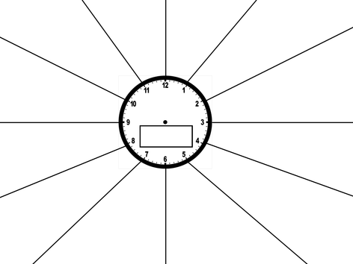

Slide 67
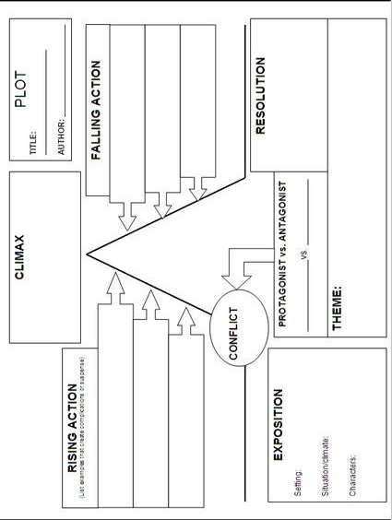
Structure worksheet

Slide 68
Use the Web!
AQA website, specimen papers and mark schemes from the exam board: http://www.aqa.org.uk/exams-administration/exams-guidance/find-past-papers-and-mark-schemes
BBC website, revision and skill development: Literature: https://www.bbc.co.uk/education/examspecs/zxqncwx
Geoff Barton (English specialist) website, advice and student revision resources: http://www.geoffbarton.co.uk/
GCSEPod website, short revision videos on exam questions and exam techniques: https://www.gcsepod.com/gcsepod_content/english/
ACC Essay questions: https://www.aylesford.kent.sch.uk/images/documents/A_Christmas_Carol_-_Exam_Practice.pdf
YouTube videos, helpful revision tips and breakdowns of exam questions:
Mr Bruff: https://www.youtube.com/user/mrbruff/playlists
Revision With Eve:
https://www.youtube.com/channel/UCD2h_l6FMIta19ronaayedg/videos
Mrs Whelan’s English: https://www.youtube.com/channel/UC0jbf4wI1GPts6hpbKZ-7Bw/playlists

Slide 69
Literary Terms
allusion a reference in one work of literature to a person, place, or event in another work of literature or in history, art, or music. Example: the band Veruca Salt is an allusion to the character Veruca Salt in the film Willy Wonka and the Chocolate Factory.
analogy an extended comparison showing the similarities between two things. Example: Juliet’s comparison of a rose and Romeo in her soliloquy.
antagonist the character or force that works against the protagonist; introduces the conflict.
aside words spoken by a character in a play, usually in an undertone and not intended.
blank verse unrhymed iambic pentameter.
characterisation the personality a character displays; also, the means by which the author reveals that personality.
climax the point of greatest emotional intensity, interest, or suspense in a narrative.
conflict a struggle (between two opposing forces or characters)
couplet two consecutive lines of poetry that rhyme. Example: My only love, sprung from my only hate!/Too early seen unknown, and known too late!
diction a writer’s choice of words for clarity, effectiveness, and precision
dramatic irony a contrast between what the audience perceives and what a character does not know
epithet a descriptive adjective or phrase used to characterise someone or something. (Peter the Great). Example: Romeo! Humors! Madman! Passion! Lover! (II.i.7)
figurative language language that is not intended to be interpreted in a literal sense
foil a character who sets off another character by contrast
foreshadowing the use of hints or clues in a narrative to suggest what action is to come
iambic meter unstressed syllable followed by a stressed syllable. Example: ǎ gain.
iambic pentameter five verse feet with each foot an iamb (a total of ten syllables)

Slide 70
Literary Terms
imagery language that appeals to any sense (sight, hearing, taste, touch, or smell) or any combination of the senses
irony literary technique that portrays differences between appearance and reality
metaphor comparison between two unlike things with the intent of giving added meaning to one of them
motivation a reason that explains or partially explains why a character thinks, feels, acts, or behaves in a certain way (Motivation results from a combination of the characters personality and the situation to be dealt with.)
protagonist the main character in a play or story
pun the humorous use of a word or phrase to suggest to or more meanings at the same time Romeo: The game was ne’er so fair, and I am done. Mercutio: Tut! Dun’s the mouse, the constable’s own word! If thou art Dun, we’ll draw thee from the mire. (I.iv.39-41)
repetition the return of a word, phrase, stanza form, or effect in any form of literature (forms: alliteration; rhyme; refrain)
monologue a long, uninterrupted speech presented in front of other characters
oxymoron a figure of speech that combines apparently contradictory terms “sweet sorrow”; “loving hate”
personification a figure of speech in which an animal, object, natural force, or idea is given a personality and described as human
simile a comparison made between two dissimilar things through the use of a specific word of comparison such as like and as
situational irony a contrast between what is expected and what really happens
soliloquy a speech in which a character is alone on stage and expresses thoughts out loud
sonnet a fourteen-line lyric poem, usually written in iambic pentameter, that has one of several rhyme schemes. A sonnet form used by William Shakespeare is called the Shakespearean sonnet. It has three four-line units (quatrains) followed by a concluding two-line unit (couplet). The most common rhyme scheme for the Shakespearean sonnet is abab cdcd efef gg

Slide 71
Literary Terms
symbol any object, person, place, or action that has a meaning in itself and that also stands for something larger than itself—such as a quality, attitude, belief, or value.
suspense that quality of a literary work that makes the reader or audience uncertain or tense about the outcome of events
theme the central idea of a work of literature
verbal irony a contrast between what is said and what is meant
Task:
Choose the literary terms you do not know and create flash cards for them. Keep testing yourself until you can confidently recall them.
Remember: a lot of these techniques are relevant across all/some of your papers!

